Slide 1
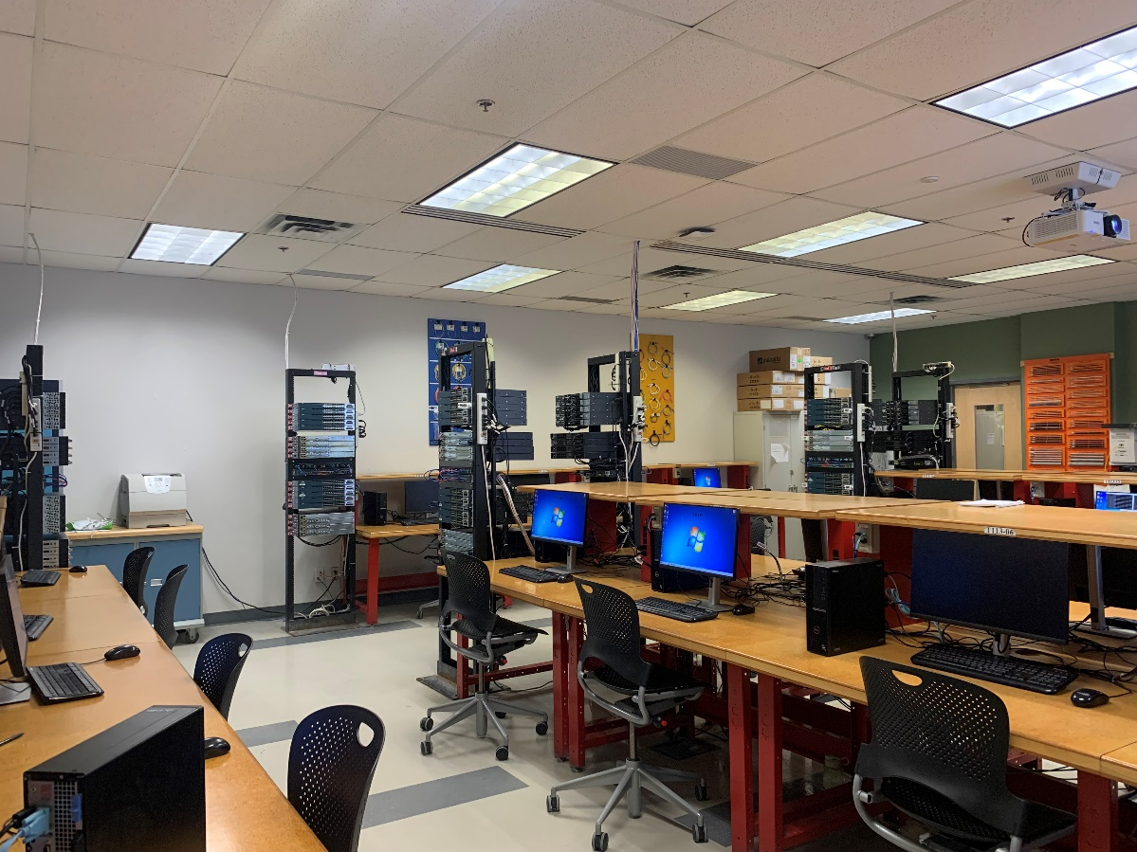
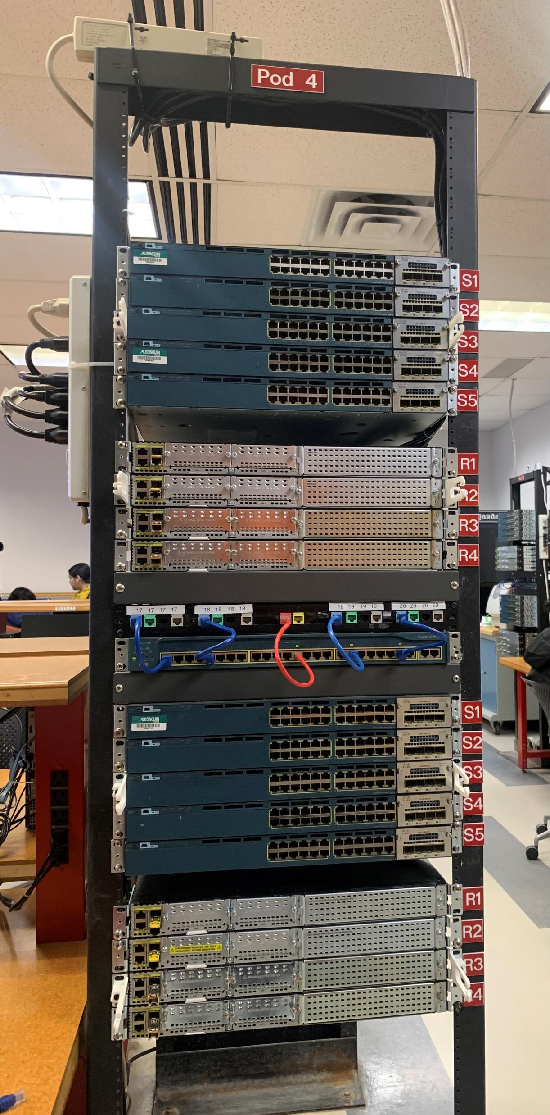
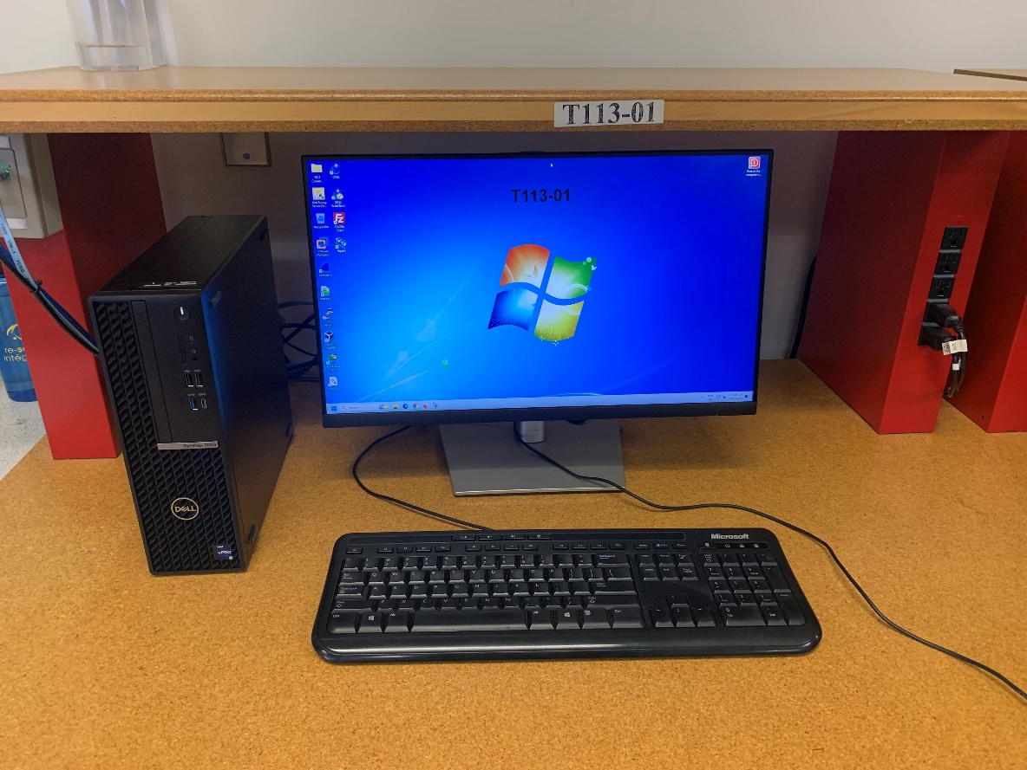
T113 Lab Orientation

Slide 2
Introduction
Welcome to lab T113’s self-guided tour!
You will learn important aspects of the lab, in particular:
The lab topology and its implementation of the elements of a “real-world”
structured cabling infrastructure
The student’s workstation and connections to the network
The “Racks” where all cables terminate and connections to network
equipment is performed
The default lab configuration

Slide 3
Instructions
Carefully read and understand each slide as well as examine related pictures.
You need to be able to answer all questions in the last slide of the presentation.

Slide 4


Lab T113
Your networking lab where you will spend many hours!
Equipped with:
Routers
Switches
Structured cabling infrastructure
Workstations

Slide 5

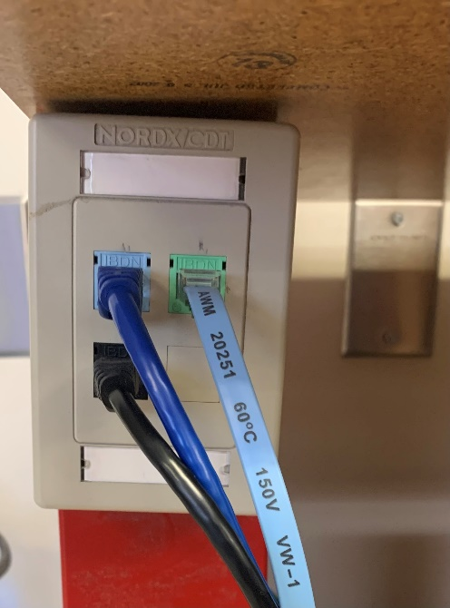
The Student’s Workstation Area
Each student is assigned a workstation.
There are 24 student workstations uniquely identified with a number ranging from 1 to 24 located at the top of each related shelf, at the workstation’s network jacks and in the desktops background image.
Each student’s workstation area consists of:
A desktop computer with monitor, mouse, and keyboard running Windows 11 and two ethernet network interface adaptors (NIC)
Three RJ45 network jacks for network
connection

Slide 6
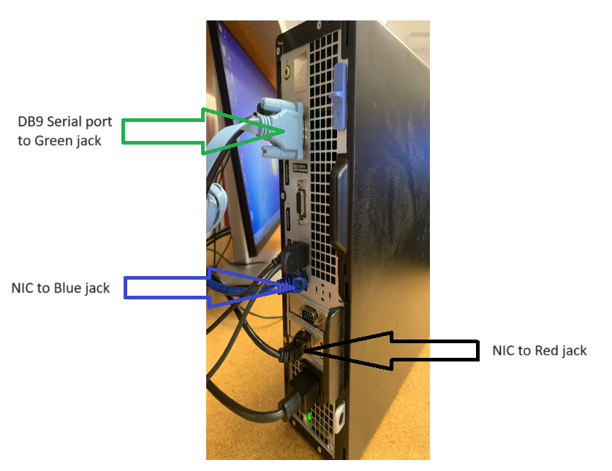
The Desktop Computer Connections
Looking at the back of the desktop, connections and interface types are shown in the image on the right. In particular:
Two network interface cards (NIC) to connect to ethernet networks
Onboard NIC to blue RJ45 jack Configured for Static addressing
Realtek NIC to black RJ45 jack (used for connecting to virtual machine)
Monitor (not shown)
USB ports
connections to cisco equipment
1 USB port connected to keyboard
1 USB port connected to mouse
Serial port to green RJ45 jack for console connections to cisco equipment

Slide 7

The Workstation’s RJ45 Network Jack
The connections and cable types from the workstation’s RJ45 jacks (image on left) to the desktop are:
From Blue to desktop’s onboard NIC using a straight-through cable
From Green to desktop’s serial port using a rollover cable
From Black to desktop’s Realtek NIC via straight-through cable
The above describes default connections
THAT must be restored at the end of every lab.

Slide 8
Desktop Additional Information
The original OS image on the desktop is restored after every restart.
Do not save anything on the workstation as it will all be lost when you reboot the computer.
You will need a USB to save your lab results whenever your labs are performed with no internet connections.

Slide 9


Cabling Infrastructure
The lab’s cabling infrastructure emulates a “real-life” scenario.
In a structured cabling infrastructure, you find the following:
Horizontal cabling
Horizontal cabling connects work areas to a wiring closet.
Cable type for horizontal cabling is normally Unshielded Twisted Pair CAT 6 or above cabling (UTP)
Vertical cabling
Vertical cabling interconnects wiring closets together as well as to the data center
Cable type for vertical cabling is normally fiber-optic cabling
The network jacks at the workstation all terminate at the patch panel located in the wiring closet. Wiring closets are normally in a locked room with restricted and controlled access.
Jacks are uniquely labelled using a number/color combination.

Slide 10
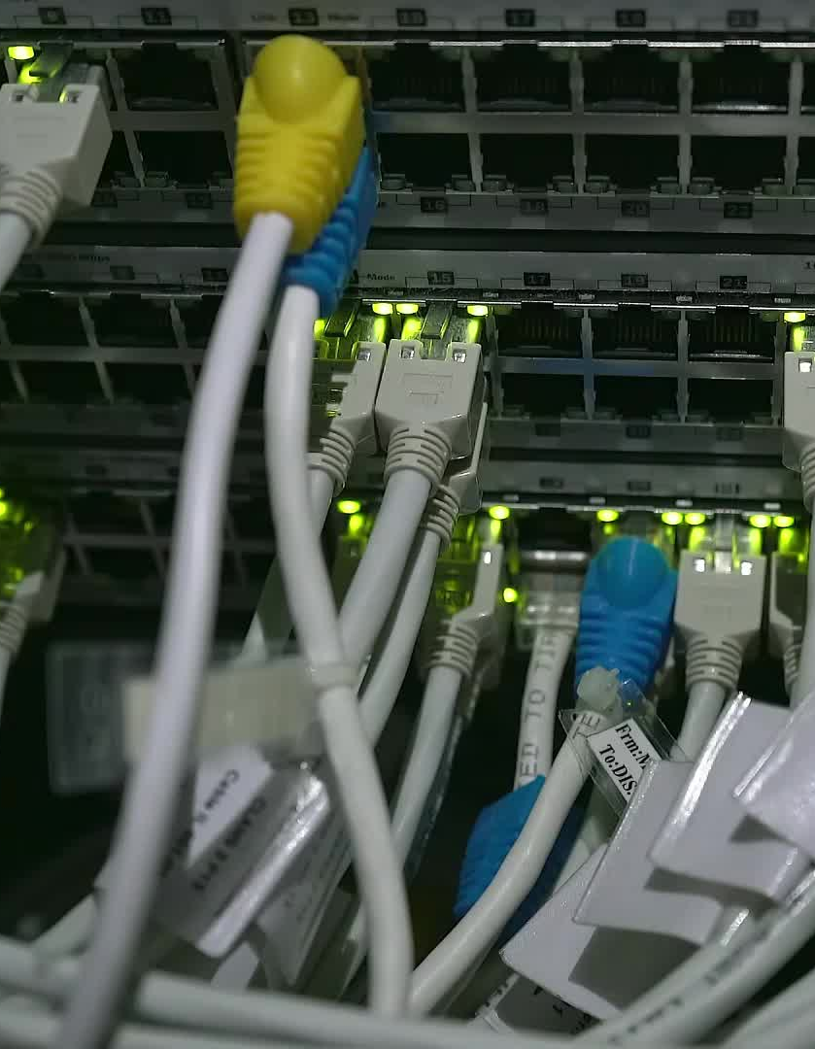
Cabling Infrastructure
Wiring Closet
You normally find one wiring closet per floor, in which the floor’s cables from
work areas are terminated at the wiring closet’s patch panel.
Each jack on the patch panel is carefully labelled.
The wiring closet also includes network devices (intermediate devices) such as routers and switches.

Slide 11

Cabling Infrastructure
Wiring Closet
The wiring closet in our lab is located at each row and equipped for 4 workstations in that specific row. These racks are labeled as POD 1 up to POD 6.
All cables from workstation’s network jacks terminate on a patch panel located in the middle of the rack.

Slide 12


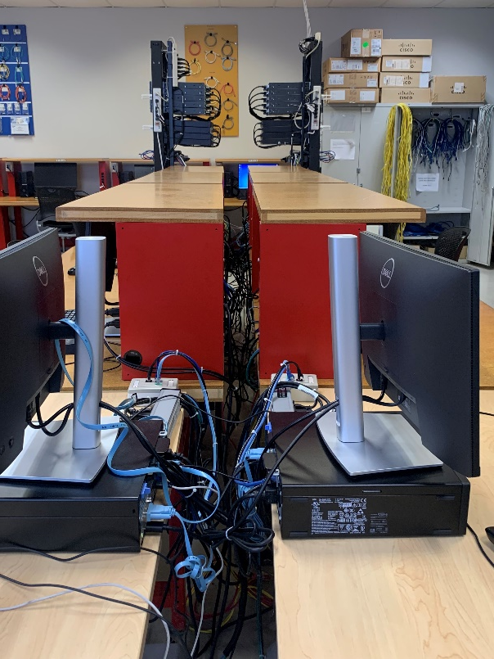
Rack Configuration
In general, we have six racks in T113 which are supporting 24 workstations.
Each workstation’s RJ45 network jack (on the left) terminates on one of the three patch panels (blue, green and black) located in the rack (on the right).
For example, workstation #18’s is terminated in the rack patch panel labelled 18 with the blue color.
Jack number 18 on BLUE patch panel is further connected to a network switch that provides network connectivity to the end device.
Note that green, black and gray patch panels are not connected to any intermediary device!
Gray patch panel is used for connection to a Multi Layer switch for a specific purposes. (in this course we do not work with gray and black patch panels)
Important: Workstation #18 cabling at the patch panel represents the default cabling configuration that MUST be restored by students at the end of each lab.

Slide 13
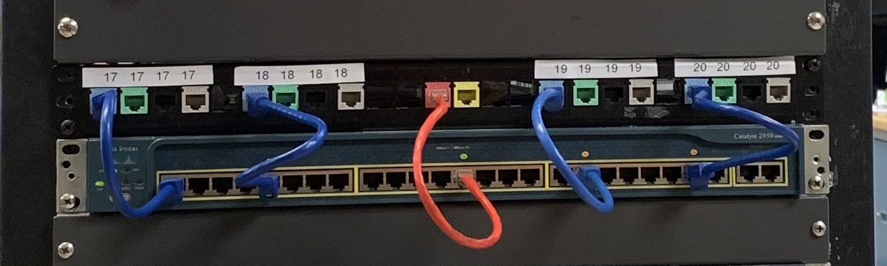
Rack Configuration
Besides those blue, green, black and gray patch panels, there are two other jacks in the middle as shown in the picture.
Red jack: provides connectivity to internet and is configured to provide automatic addressing (DHCP).
Yellow jack: provides connectivity to a private network called “eagle network”. This network is also configured to to provide automatic addressing (DHCP).

Slide 14
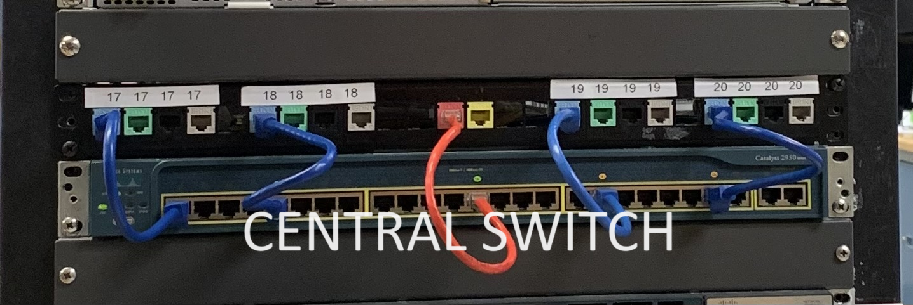
End to End Connectivity Review
How your lab desktop connects to the network:
A straight-through cable also called a patch cable connects your workstation’s Network Interface Card (NIC) to your work area’s RJ45 Network Jack.
A cable of unshielded twisted pair (UTP) type of CAT 6 or above runs from your work area’s RJ45 Network Jack and is terminated on a patch panel in the rack at the end of row.
This portion of the cabling runs behind the shelf and is permanent cabling and its maximum distance is 90m.
A patch cable runs from your patch panel’s RJ45 Jack to an intermediary device, normally an Ethernet switch to complete the network connection!
The max cabling length from the desktop’s Network Interface card to the intermediary device in the wiring closet is 100m maximum.
The network you have access to depends on what network the switch is connected to!
As described in previous slides, when the default cabling configuration is implemented at both the workstation and the rack, the Realtek Network interface connects your desktop to the “central switch” located in the middle of the rack immediately below the patch panels. The “central switch” is then connected to the red jack (to provide internet to workstations) and further connected to a router that provides connectivity to the college network. As you will soon learn, network connectivity also depends on your workstation’s IPv4 addressing being properly configured.

Slide 15
Lab Default Configuration
As noted in earlier slides, students are responsible for ensuring that the cabling at both the workstation and at the patch panel is returned to its default settings. Failure to do so results in loss of marks.

Slide 16
Equipment Rack Configuration Overview
Excluding the access switch and patch panel at the middle of each rack, each rack hosts identical equipment configurations consisting of L3 switches and Integrated Services Routers. Each rack has a total of 8 switches labelled S1 to S4 at the top and bottom and 8 routers labelled R1 to R4 at the top and bottom.
A picture of rack and its equipment is shown on the next slide.
Students will build, configure and test networks using the equipment in the racks.

Slide 17
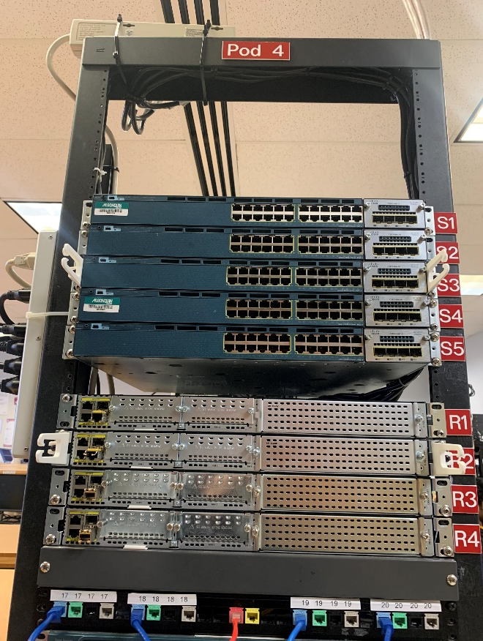
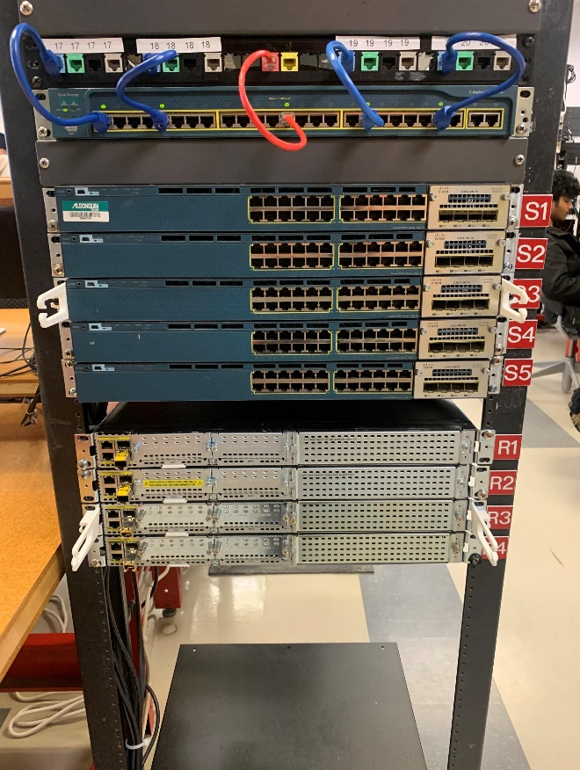
Equipment Rack Configuration
Notes:
The pod number is at the very top of the rack. POD 4 in the photo.
The top half of POD 4 is shown on the left and the bottom half on the right.
Equipment label is to the right. S1 to S4 and R1 to R4.
Further information about the equipment will be provided as you progress through the course.

Slide 18
Review
What is your workstation’s number?
Which network jack does your Onboard NIC connect to?
What is the purpose of the serial port connection?
What type of cable connects the serial port to the RJ45 jack?
What type of cable connects the onboard NIC to the RJ45 jack?
Are your Black, Green and Gray network jacks connected to devices at the patch panel?
Which NIC has it’s IPv4 address assigned manually (static addressing)?
Which NIC provides connectivity to the college network when you have implemented default cabling at both your workstation and at the patch panel?

